Slide 1
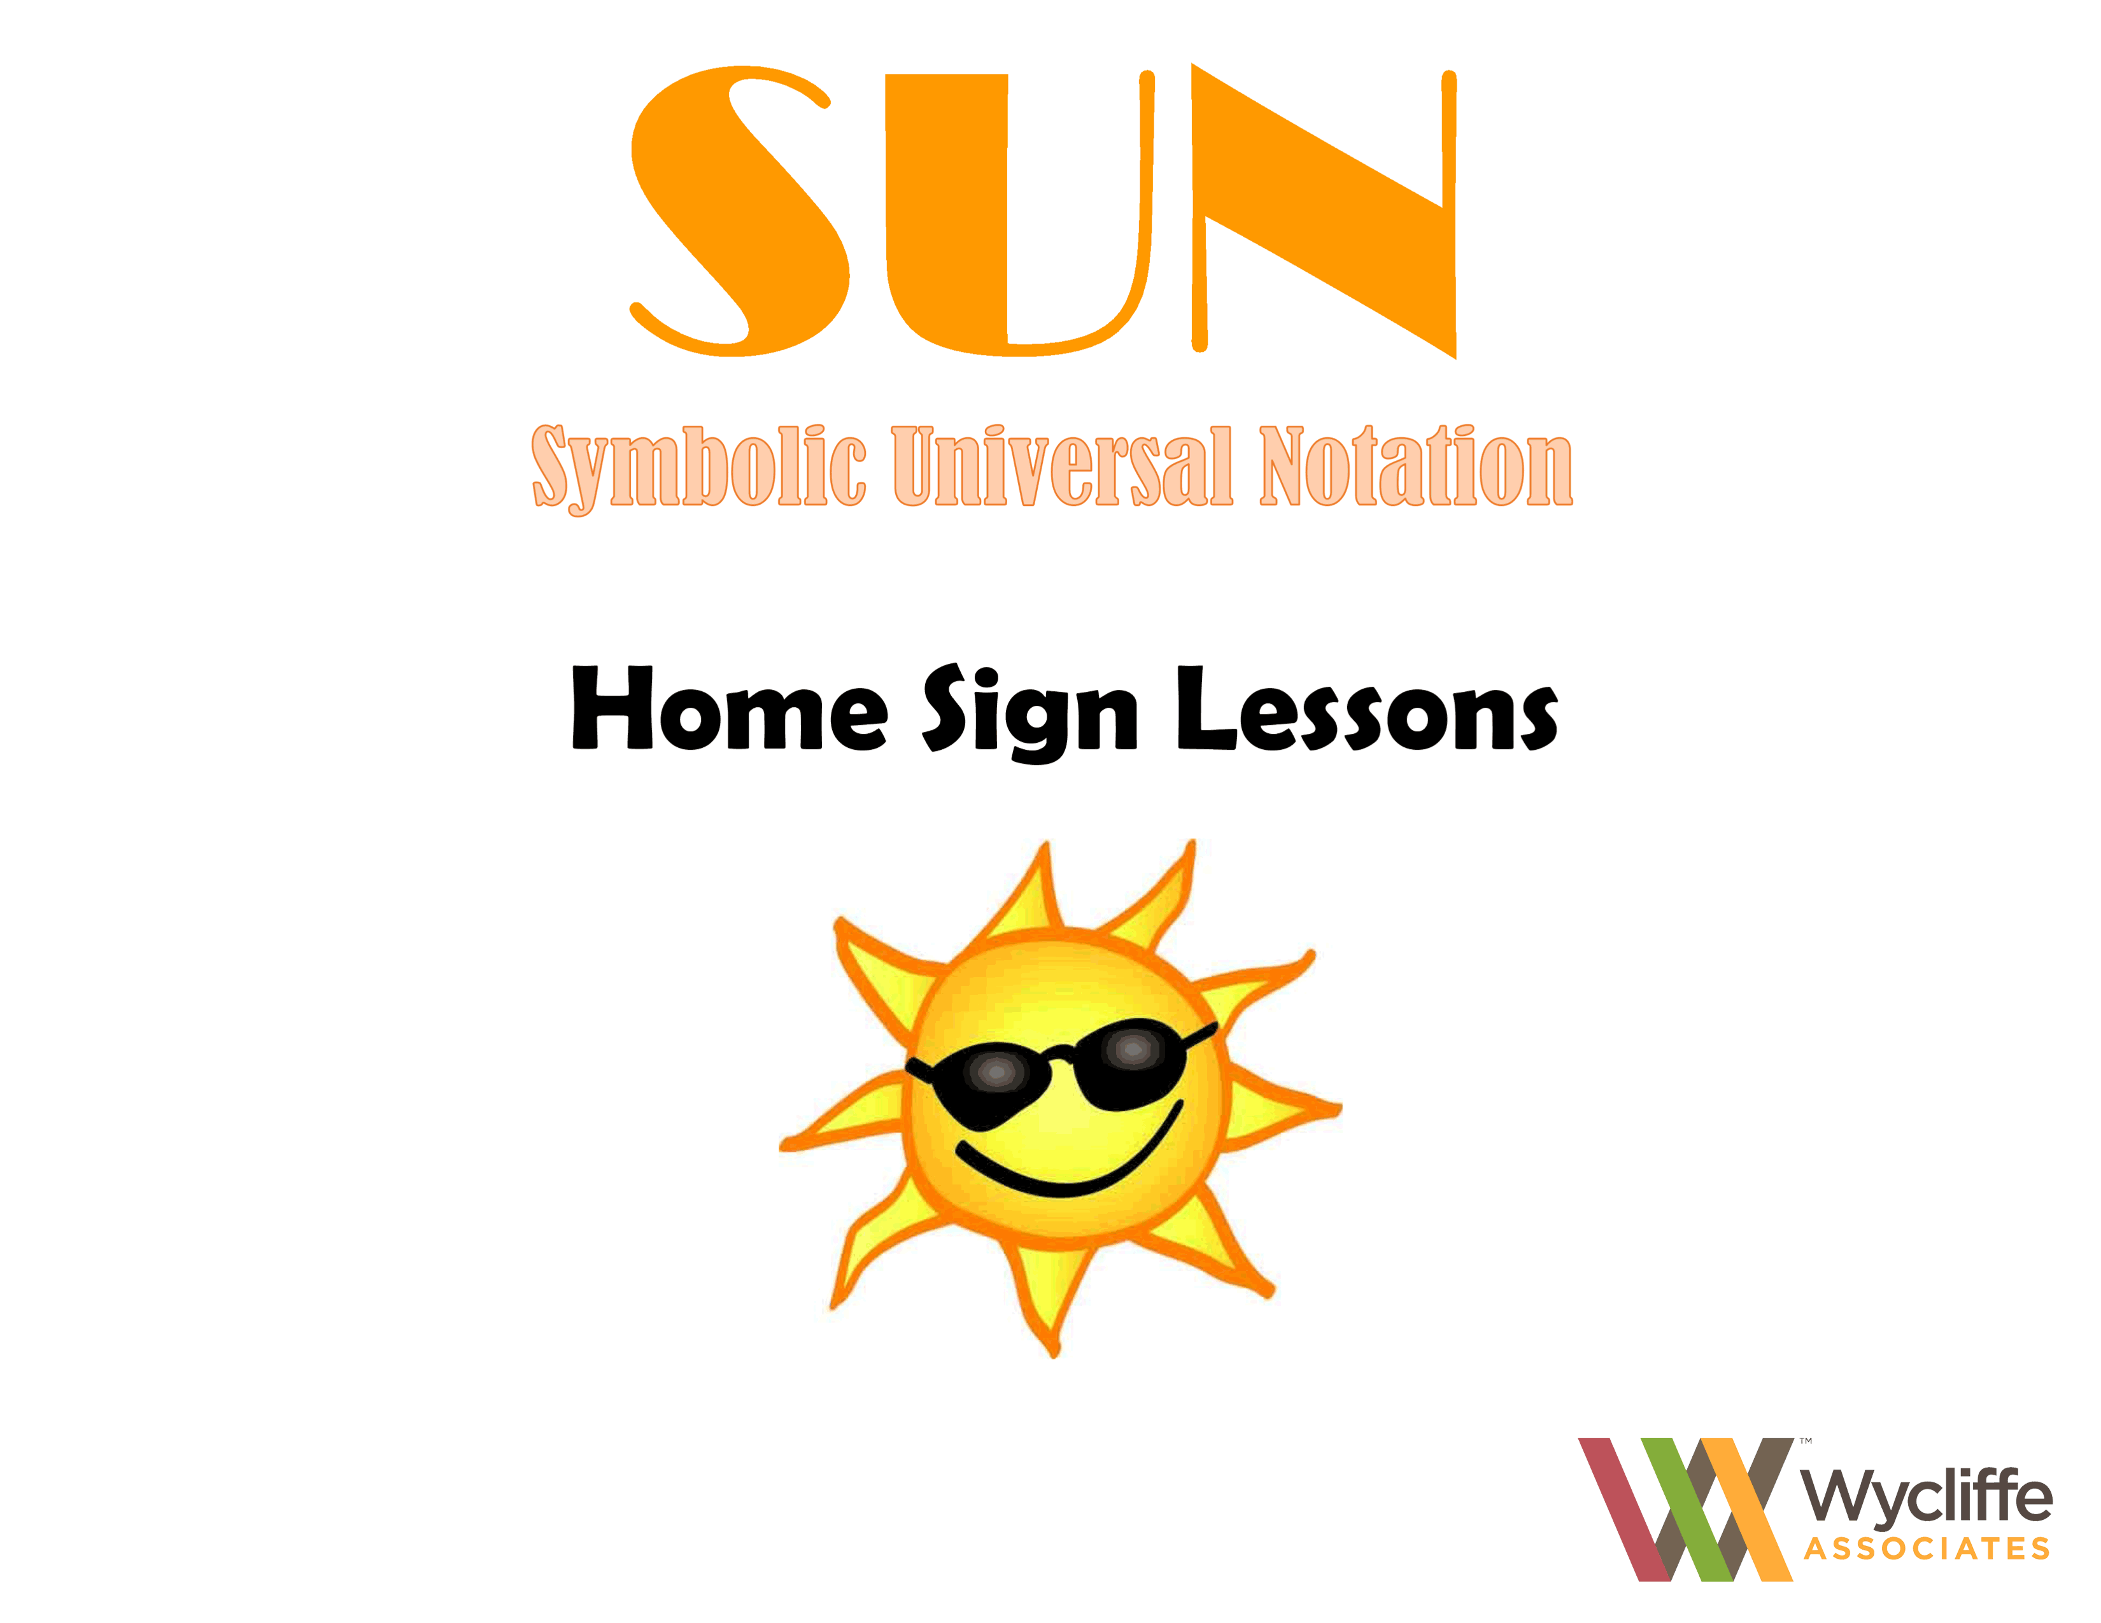
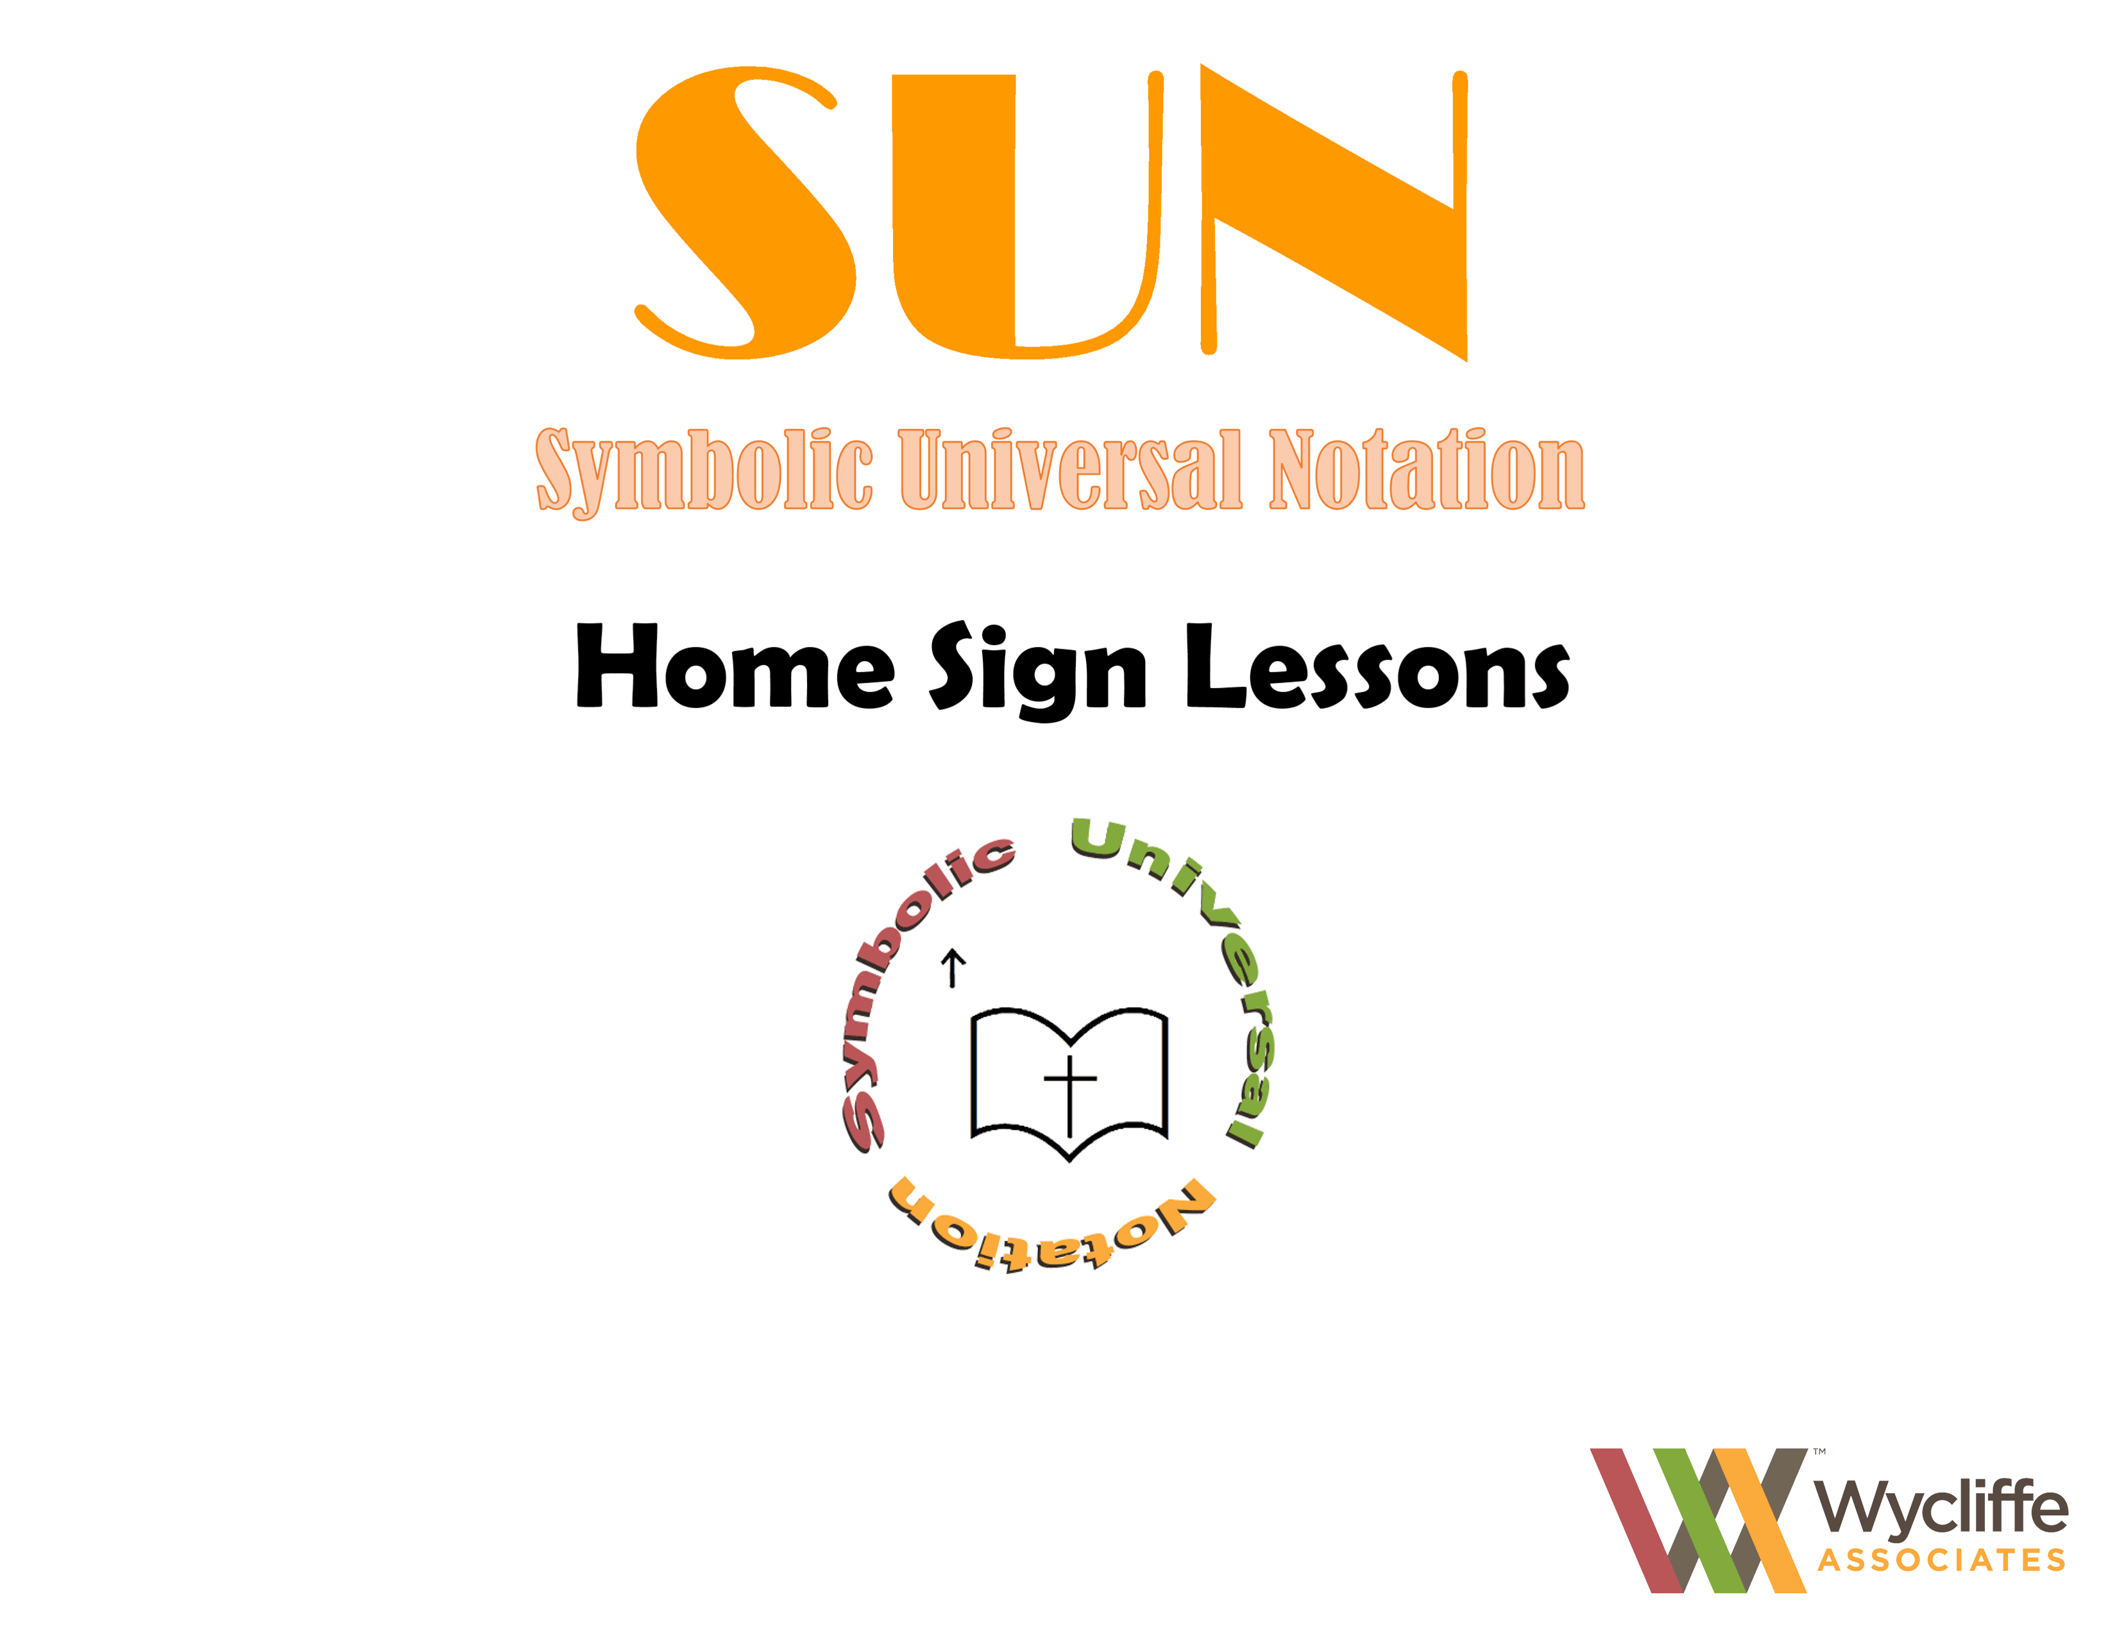

Slide 2
LESSON 1

Slide 3


Slide 4


Slide 5
pen
write

Slide 6


Slide 7
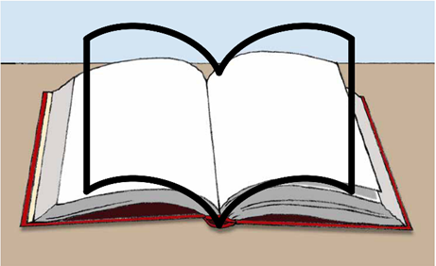

Slide 8
book
read
learn

Slide 9


Slide 10
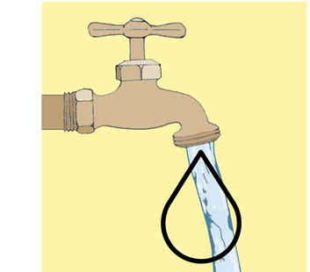

Slide 11
water
wet

Slide 12


Slide 13
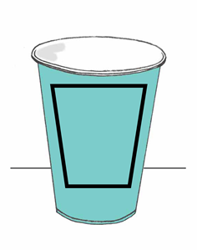

Slide 14
cup
drink

Slide 15
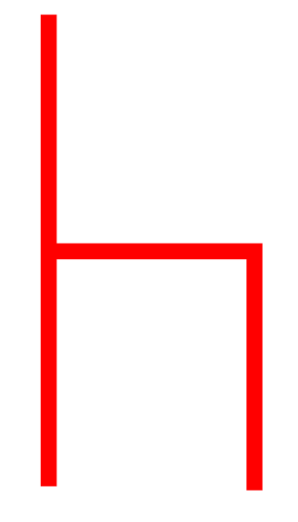

Slide 16
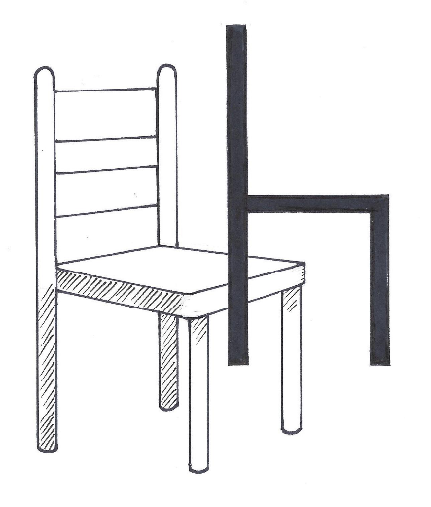

Slide 17
chair
sit

Slide 18


Slide 19
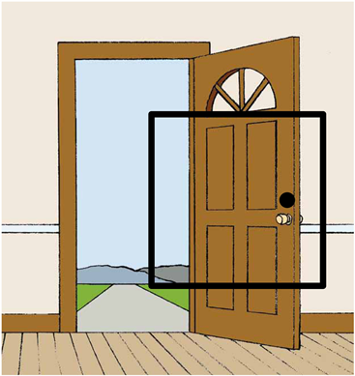

Slide 20
door

Slide 21
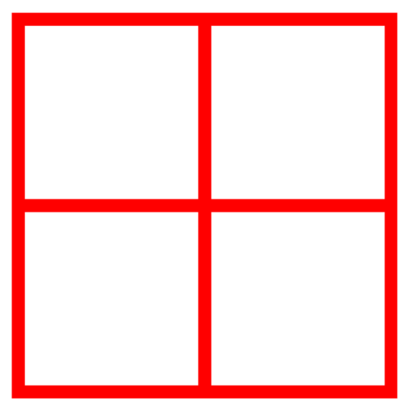

Slide 22
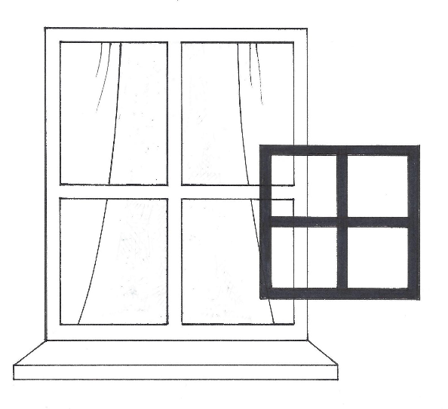

Slide 23
window

Slide 24
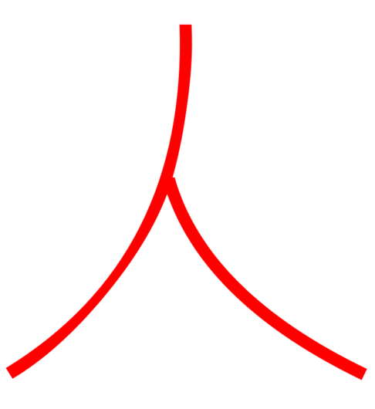

Slide 25
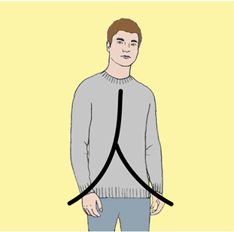

Slide 26
person

Slide 27


Slide 28
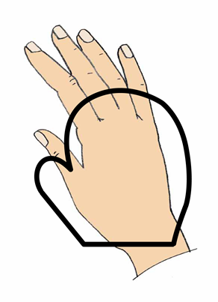

Slide 29
hand

Slide 30


Slide 31
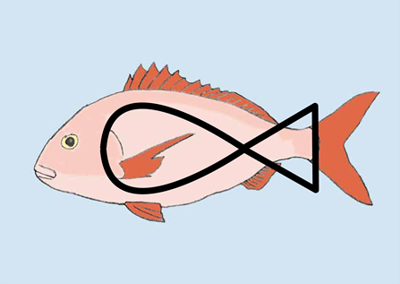

Slide 32
fish

Slide 33
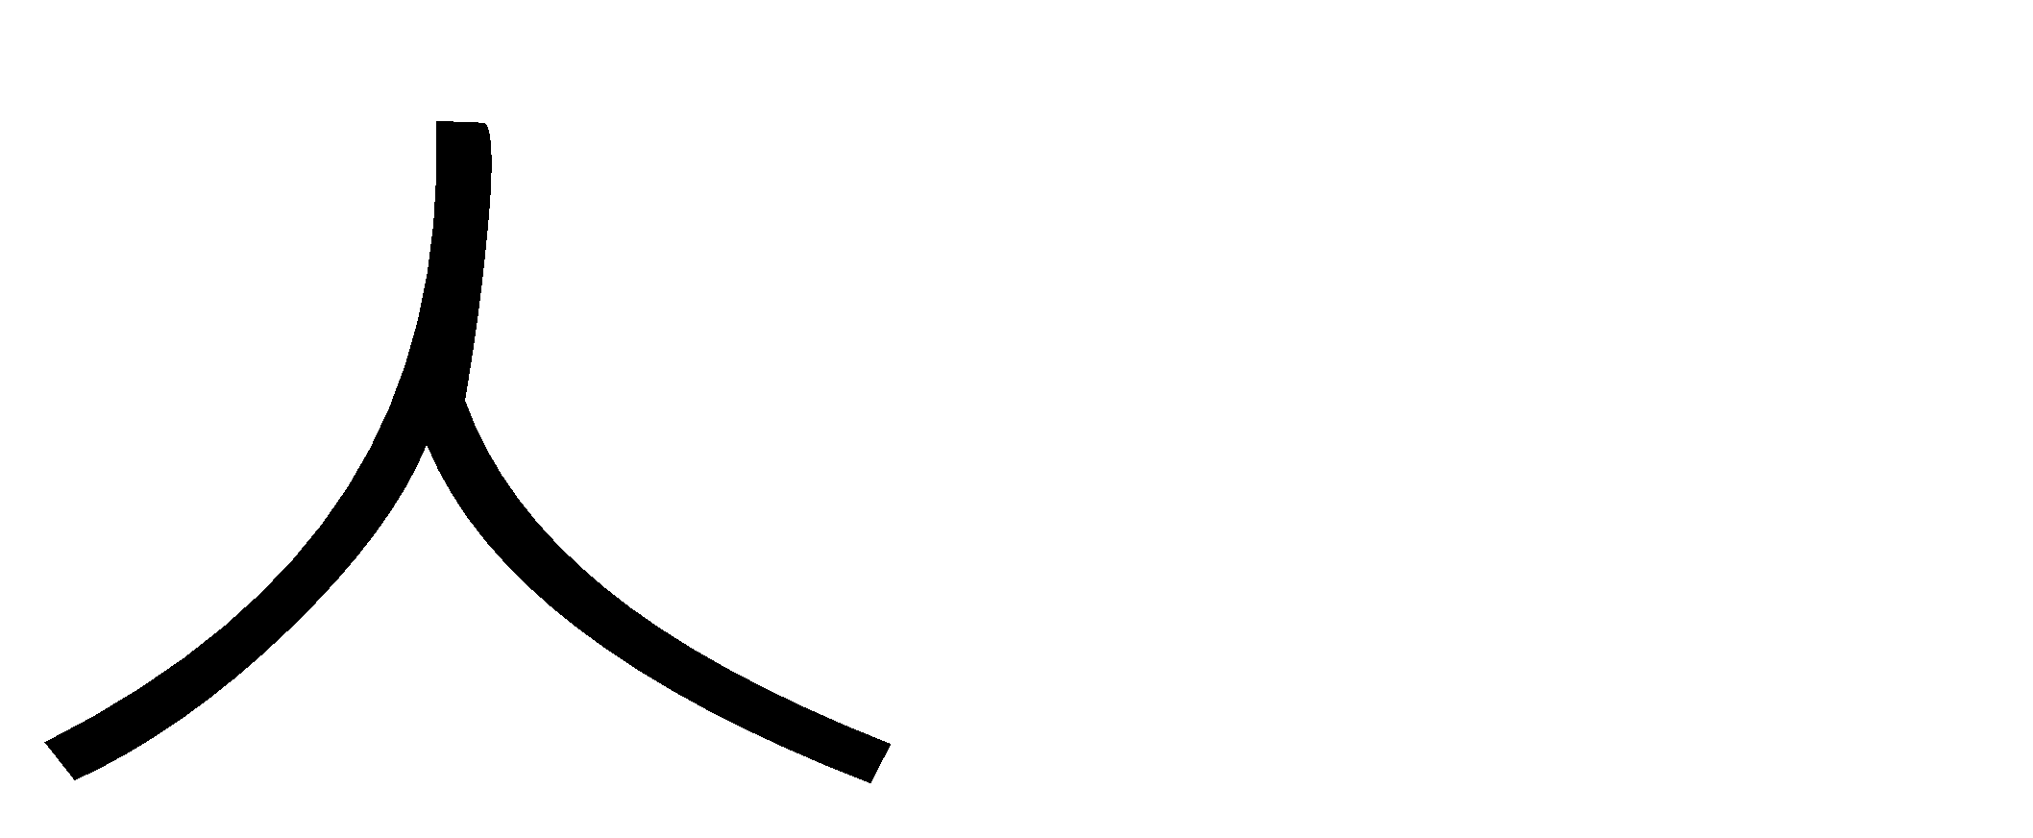
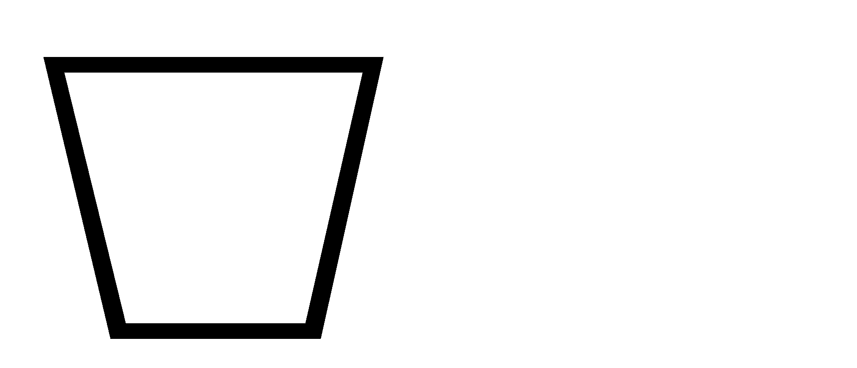
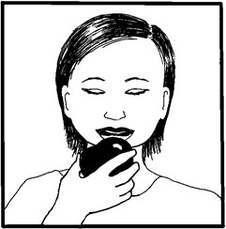
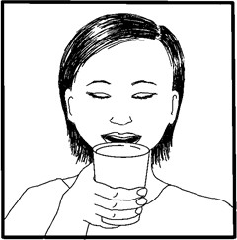
Notes:
A person drinks.

Slide 34
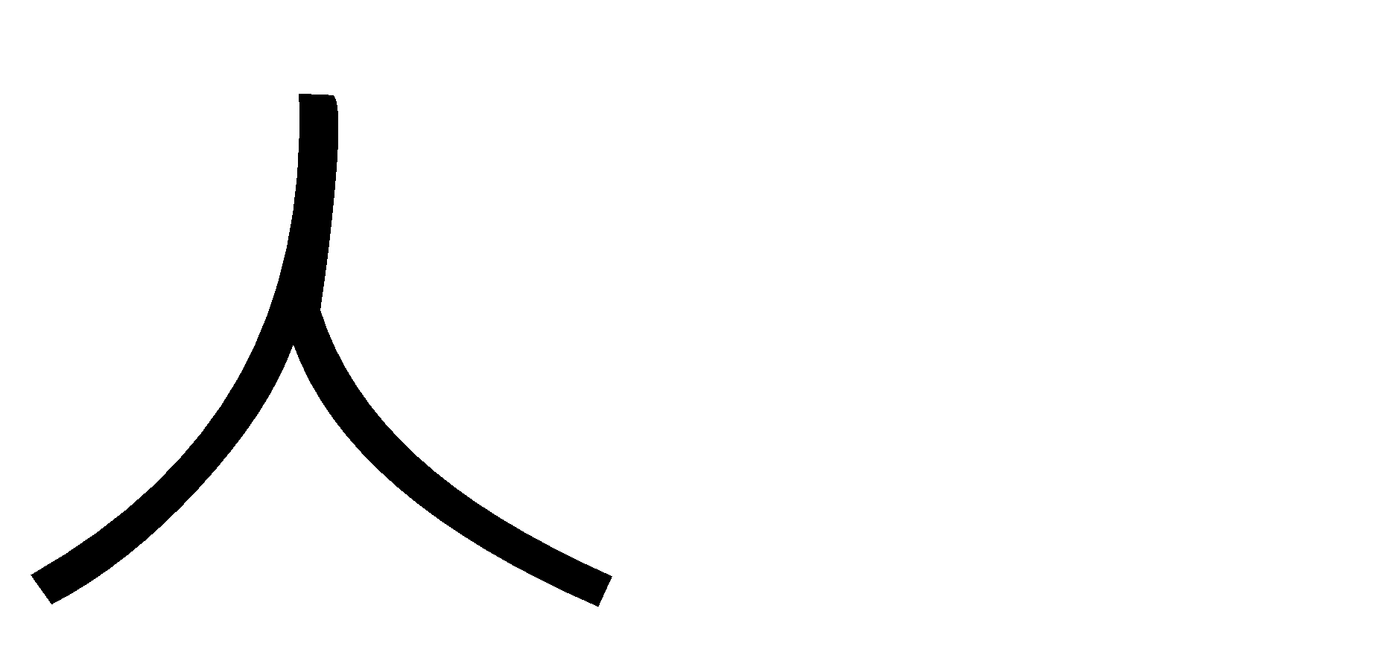

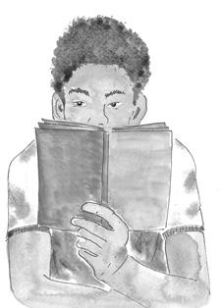
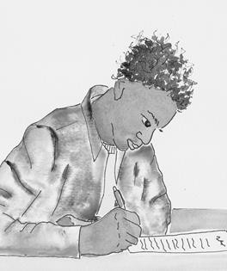
Notes:
A person writes.

Slide 35
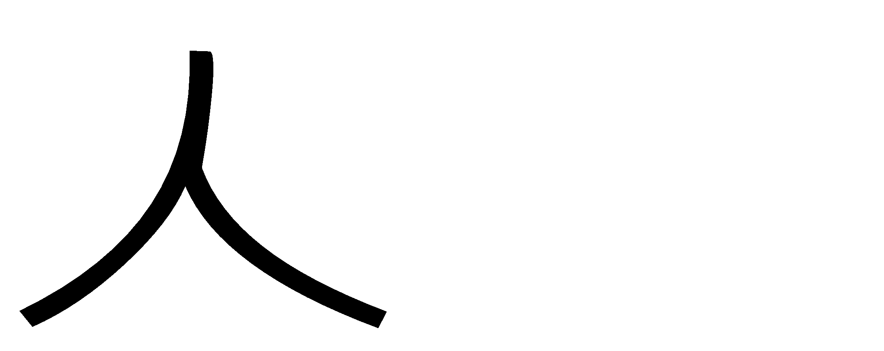

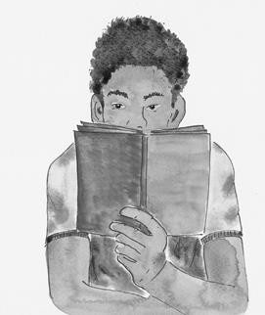

Notes:
A person reads.

Slide 36
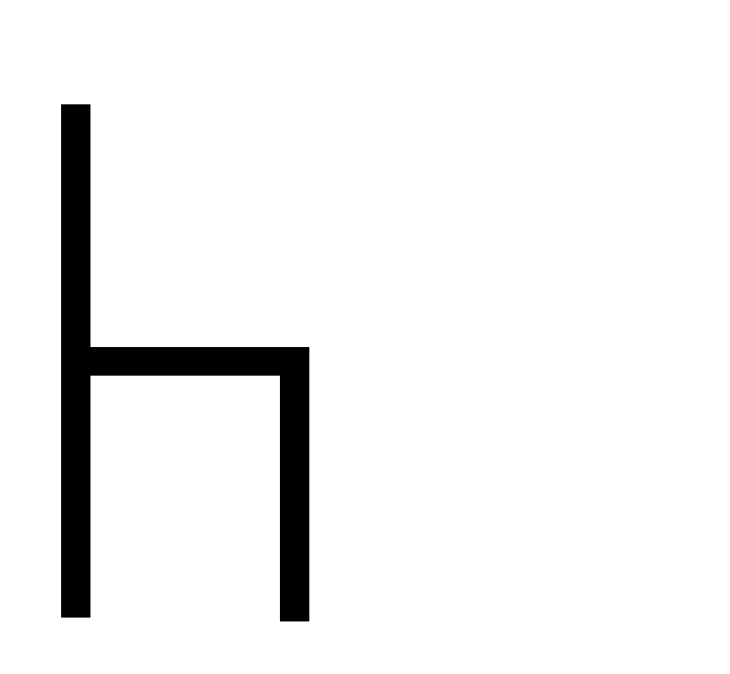
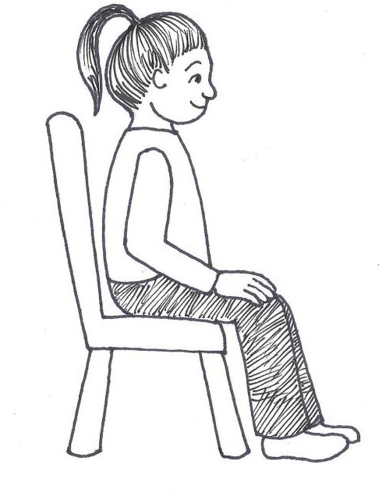
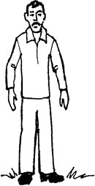
Notes:
A person sits.

Slide 37
LESSON 2

Slide 38


Slide 39
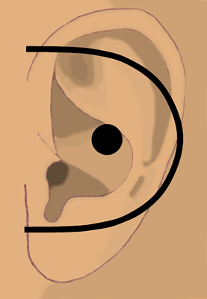

Slide 40
ear
hear

Slide 41
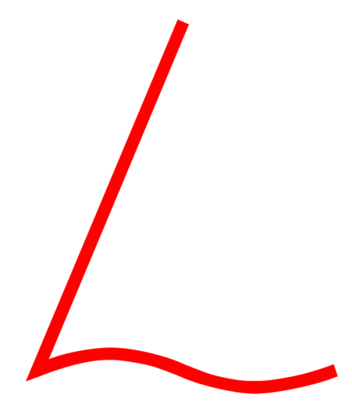

Slide 42
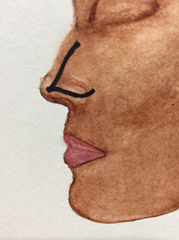

Slide 43
nose
smell

Slide 44
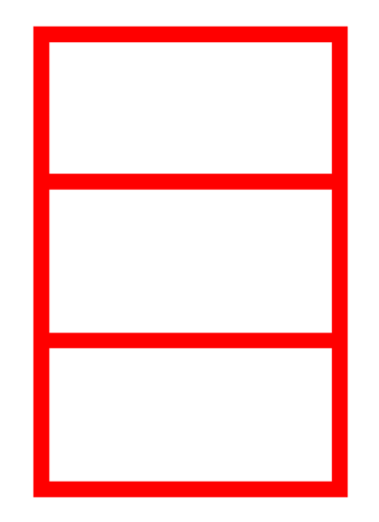

Slide 45
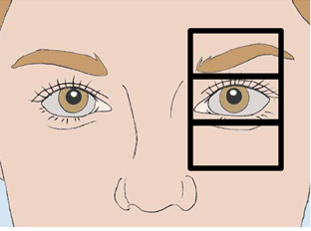

Slide 46
eye
see

Slide 47


Slide 48
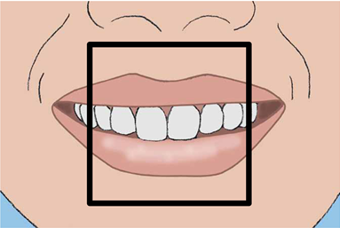

Slide 49
mouth
said
speak
confess

Slide 50
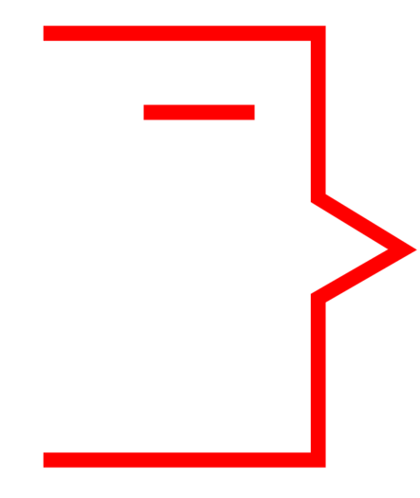

Slide 51
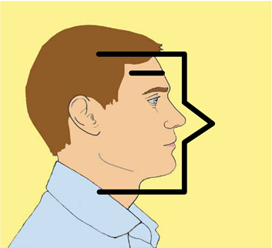

Slide 52
man

Slide 53


Slide 54


Slide 55
moon
night

Slide 56


Slide 57
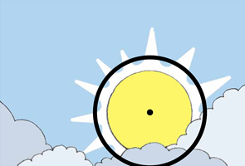

Slide 58
sun
day

Slide 59


Slide 60
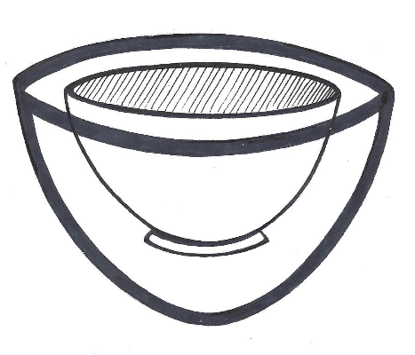

Slide 61
bowl
dish

Slide 62


Slide 63
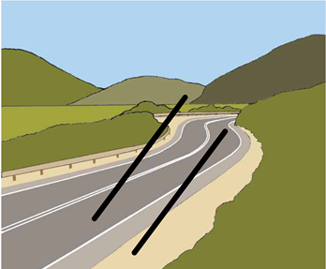

Slide 64
road
path
way

Slide 65
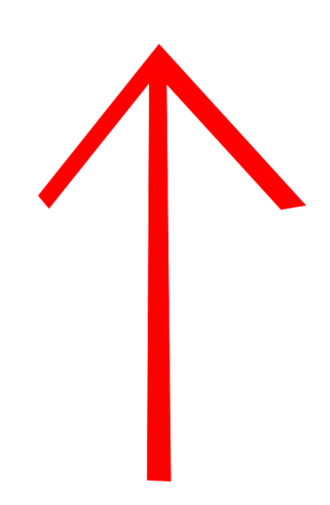

Slide 66
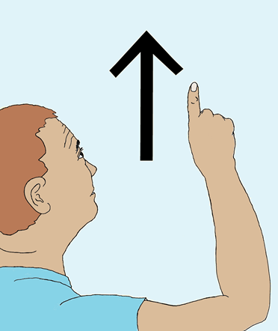

Slide 67
up

Slide 68
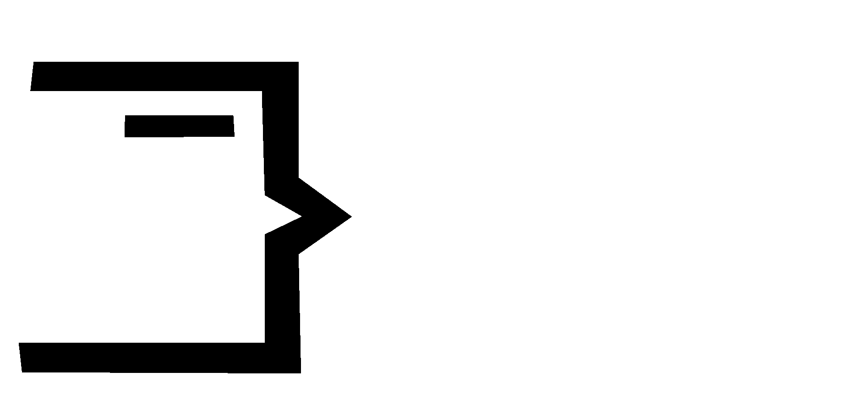
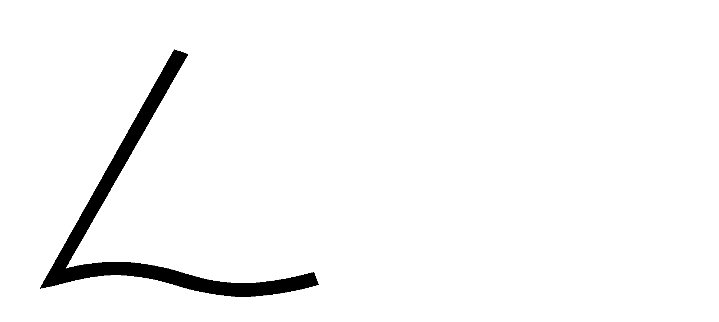

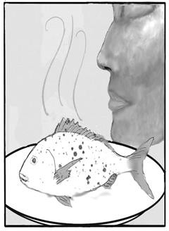
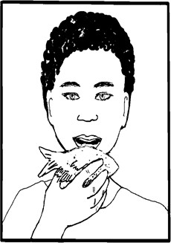
Notes:
A man smells a fish.

Slide 69
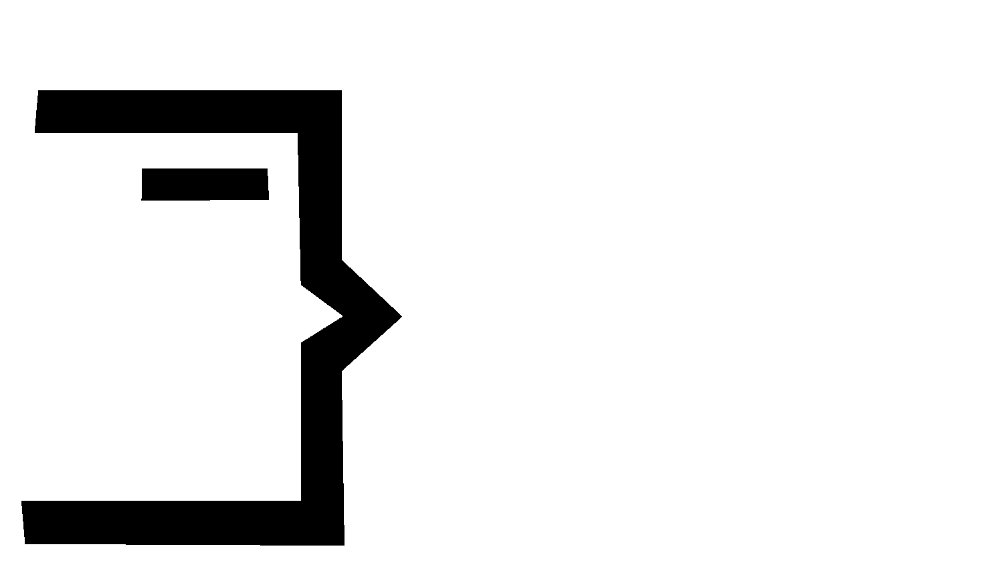

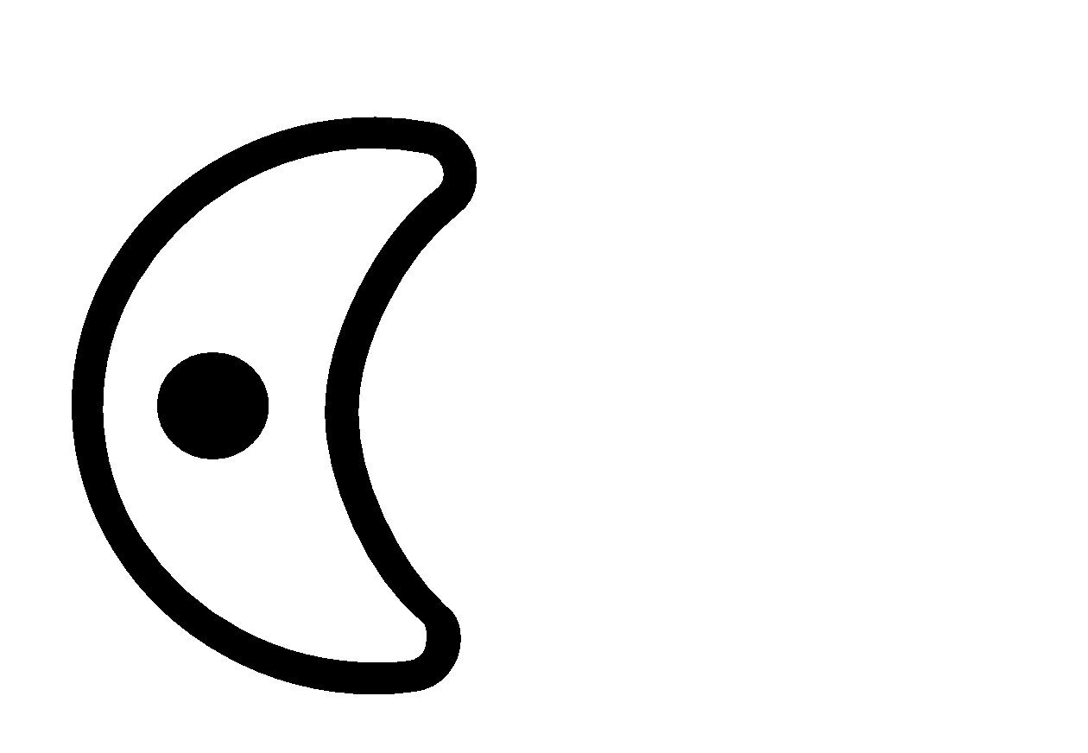
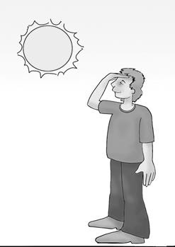
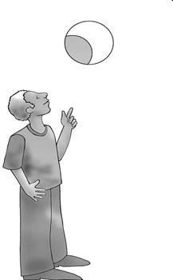
Notes:
A man sees the moon.

Slide 70

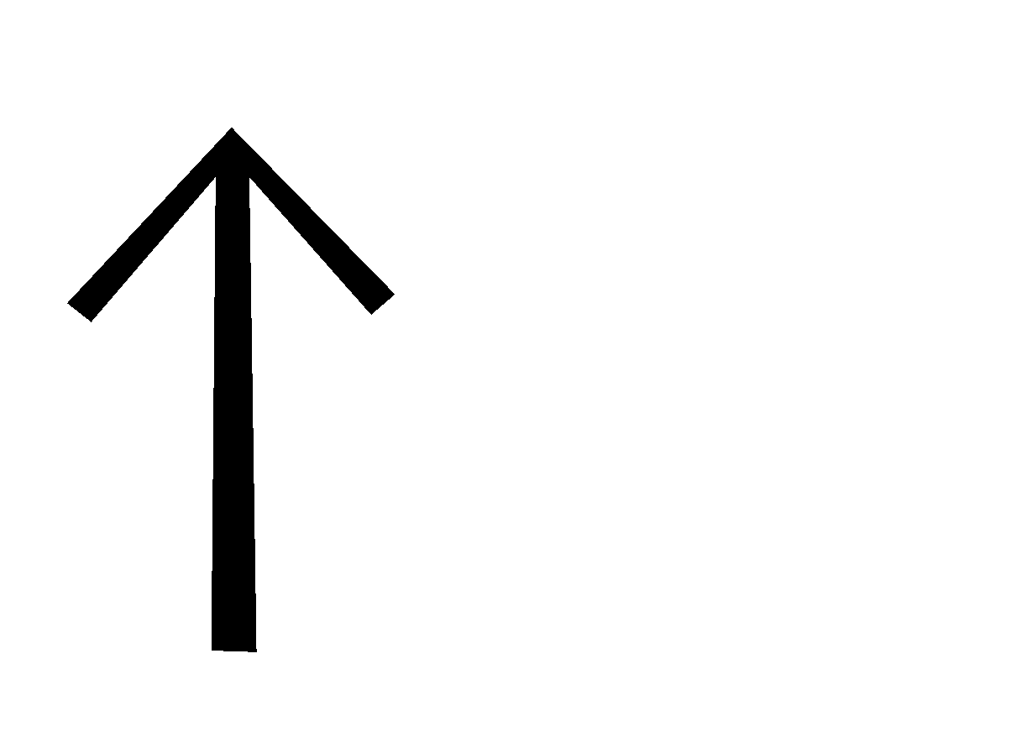
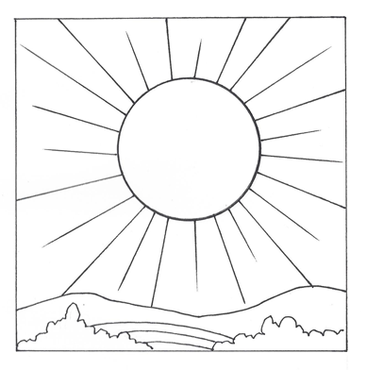
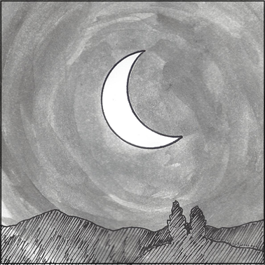
Notes:
The sun comes up.

Slide 71



Notes:
A person sees the road.

Slide 72



Notes:
A man sees the sun come up.

Slide 73



Notes:
A man hears a person speaking.

Slide 74
LESSON 3

Slide 75


Slide 76


Slide 77
I
me

Slide 78


Slide 79


Slide 80
face

Slide 81


Slide 82


Slide 83
table

Slide 84


Slide 85


Slide 86
house

Slide 87


Slide 88


Slide 89
tree
plant
wood

Slide 90


Slide 92

fruit

Slide 93


Slide 94


Slide 95
box

Slide 96


Slide 97


Slide 98
chain
bound
arrest
imprisoned

Slide 99


Slide 100


Slide 101
no not

Slide 102


Slide 103


Slide 104
king
lord
ruler
master

Slide 105



Notes:
The king speaks to me.

Slide 106



Notes:
I don’t see the house.

Slide 107



Notes:
A person is chained to a tree.

Slide 108



Notes:
The table has a box of fruit.

Slide 109



Notes:
I see a tree on the road.

Slide 110



Notes:
The house has no windows.

Slide 111
LESSON 4

Slide 112


Slide 113


Slide 114
river
stream

Slide 115


Slide 116


Slide 117
boat

Slide 118


Slide 119


Slide 120
storm

Slide 121


Slide 122


Slide 123
walk

Slide 124


Slide 125


Slide 126
knife
cut

Slide 127


Slide 128


Slide 129
sword

Slide 130


Slide 131


Slide 132
belt

Slide 133


Slide 134


Slide 135
stick

Slide 136


Slide 137


Slide 138
grain
wheat

Slide 139


Slide 140


Slide 141
stair
level

Slide 142



Notes:
I walk the road to the house.

Slide 143



Notes:
There is no boat in the storm.

Slide 144



Notes:
A person walks up the stairs.

Slide 145



Notes:
A man cuts the fruit on the table.

Slide 146



Notes:
The king has no belt.

Slide 147



Notes:
The man cuts the grain.

Slide 148
LESSON 5

Slide 149


Slide 150


Slide 151
animal

Slide 152


Slide 153


Slide 154
pig

Slide 155


Slide 156


Slide 157
snake

Slide 158


Slide 159


Slide 160
camel

Slide 161


Slide 162


Slide 163
horse

Slide 164


Slide 165


Slide 166
insect

Slide 167


Slide 168


Slide 169
hole

Slide 170


Slide 171


Slide 172
tie
knot

Slide 173


Slide 174


Slide 175
stretch

Slide 176


Slide 177


Slide 178
equal
same

Slide 179



Notes:
The man stretches the belt.

Slide 180



Notes:
A horse is tied to a tree.

Slide 181



Notes:
The pig does not walk.

Slide 182



Notes:
A horse is not the same as a camel.

Slide 183



Notes:
A person ties a belt.

Slide 184



Notes:
The house does not have any animals.

Slide 185
LESSON 6

Slide 186


Slide 187


Slide 188
fire
hot
heat

Slide 189


Slide 190


Slide 191
star

Slide 192


Slide 193


Slide 194
net

Slide 195


Slide 196


Slide 197
mountain

Slide 198


Slide 199


Slide 200
heart

Slide 201


Slide 202


Slide 203
work
do

Slide 204


Slide 205


Slide 206
fly

Slide 207


Slide 209
sweet

Slide 210


Slide 211


Slide 212
straight

Slide 213


Slide 214


Slide 215
soft

Slide 216



Notes:
I cut a hole in the box.

Slide 217



Notes:
The sun is hot.

Slide 218



Notes:
The insect flies straight.

Slide 219



Notes:
The fruit is sweet.

Slide 220



Notes:
The man sees a hole in the net.

Slide 221



Notes:
Fire goes up from the mountain.

Slide 222
LESSON 7

Slide 223


Slide 224


Slide 225
bone

Slide 226


Slide 227


Slide 228
wall

Slide 229


Slide 230


Slide 231
tower

Slide 232


Slide 233


Slide 234
land
ground
space
earth

Slide 235


Slide 236


Slide 237
shield

Slide 238


Slide 239


Slide 240
whip

Slide 241


Slide 242


Slide 243
measure

Slide 244


Slide 245


Slide 246
left

Slide 247


Slide 248


Slide 249
time
when

Slide 250


Slide 251


Slide 252
cross

Slide 253



Notes:
The fish has no bones.

Slide 254



Notes:
The animal works the grain field.

Slide 255



Notes:
The tower is to the left of the wall.

Slide 256



Notes:
I whip the horse.

Slide 257



Notes:
A man measures the stick.

Slide 258



Notes:
I do not have time to write.

Slide 259
LESSON 8

Slide 260


Slide 261


Slide 262
part
some

Slide 263


Slide 264


Slide 265
all
whole

Slide 266


Slide 267


Slide 268
color

Slide 269


Slide 270


Slide 271
good

Slide 272


Slide 273


Slide 274
start
beginning

Slide 275


Slide 276


Slide 277
from

Slide 278


Slide 279


Slide 280
air

Slide 281


Slide 282


Slide 283
love
compassion

Slide 284


Slide 285


Slide 286
know
knowledge

Slide 287


Slide 288


Slide 289
new

Slide 290



Notes:
The king loves his horses.

Slide 291



Notes:
The man has a good heart.

Slide 292



Notes:
I see all colors.

Slide 293



Notes:
No air is coming from the mouth.

Slide 294



Notes:
I write a new book.

Slide 295



Notes:
I don’t know the person.

Slide 296
LESSON 9

Slide 297


Slide 298


Slide 299
zero

Slide 300


Slide 301


Slide 302
one

Slide 303


Slide 304


Slide 305
two

Slide 306


Slide 307


Slide 308
three

Slide 309


Slide 310


Slide 311
four

Slide 312


Slide 313


Slide 314
five

Slide 315


Slide 316


Slide 317
six

Slide 318


Slide 319


Slide 320
seven

Slide 321


Slide 322


Slide 323
eight

Slide 324


Slide 325


Slide 326
nine

Slide 327


Slide 328


Slide 329
ten

Slide 330
LESSON 10

Slide 331


Slide 332


Slide 333
thing

Slide 334


Slide 335


Slide 336
clothing
fabric

Slide 337


Slide 338


Slide 339
number

Slide 340


Slide 341


Slide 342
thousand

Slide 343


Slide 344


Slide 345
many
much

Slide 346


Slide 347


Slide 348
near
close

Slide 349


Slide 350


Slide 351
small
few

Slide 352


Slide 353


Slide 354
very
(showing emphasis)

Slide 355


Slide 356


Slide 357
people
(persons)

Slide 358


Slide 359


Slide 360
woman

Slide 361
LESSON 11

Slide 362


Slide 363


Slide 364
crowd
multitude
(persons)

Slide 365


Slide 366


Slide 367
closed
(door)

Slide 368


Slide 369


Slide 370
open
(no, closed)

Slide 371


Slide 372


Slide 373
in
inside
(door, thing)

Slide 374


Slide 375


Slide 376
on
on_top_of
(thing)

Slide 377


Slide 378


Slide 379
away
(thing)

Slide 380


Slide 381


Slide 382
deaf
(no, ear)

Slide 383


Slide 384


Slide 385
mute
(mouth, no)

Slide 386


Slide 387


Slide 388
put
(hand, thing)

Slide 389


Slide 390


Slide 391
touch
(thing, hand)

Slide 392
LESSON 12

Slide 393


Slide 394


Slide 395
bring
take
carry
(hand, thing)

Slide 396


Slide 397


Slide 398
tongue
(mouth, clothing)

Slide 399


Slide 400


Slide 401
spit
(mouth, forward, water)

Slide 402


Slide 403


Slide 404
sigh
(mouth, air)

Slide 405


Slide 406


Slide 407
free
freedom
(no, chain)

Slide 408


Slide 409


Slide 410
desire
want
will
like
(love, heart)

Slide 411


Slide 412


Slide 413
beg
(very, mouth, desire)

Slide 414


Slide 415

Jesus
(king, cross)
.

Slide 416


Slide 417


Slide 418
father
(man, love)

Slide 419


Slide 420

God
(king, father)

Slide 421


Slide 422

heaven
(house, God)

Slide 423
LESSON 13

Slide 424


period
This symbol marks the end of a complete thought.

Slide 425


comma
This symbol indicates a break within a complete thought.

Slide 426


exclamation point
This symbol marks the end of a sentence spoken with emphasis or strong emotion.

Slide 427


question mark
This symbol indicates a question is being asked.

Slide 428


quotation marks
These symbols appear at the beginning and end of something that someone says.

Slide 429


NOTE:
John 16:1-16 are in quotes – Jesus is
speaking to disciples. Part of John 16:5
is in single quotes:
single quote marks
These symbols are used to indicate a quotation inside another quotation.

Slide 430



possessive
This symbol is used to show possession.

Slide 431




indicator of
Proper Noun
This symbol indicates a Proper Noun -
name of a man, woman, village, land, or sea.

Slide 432


Notes:
They brought to Jesus someone who was deaf and had difficulty speaking.

Slide 433

Notes:
They begged Jesus to lay his hand on him.

Slide 434


Notes:
Jesus took him aside from the crowd privately.

Slide 435


Notes:
Jesus put His fingers into his ears.

Slide 436


Notes:
After spitting

Slide 437


Notes:
Jesus touched his tongue.

Slide 438


Notes:
Jesus looked up to Heaven.

Slide 439


Notes:
Jesus sighed.

Slide 440


Notes:
Jesus said to him “ Ephphatha, “ that is to say, “Open!”

Slide 441


Notes:
Immediately his hearing was opened.

Slide 442


Notes:
His tongue was loosened. What prevented his tongue was destroyed.

Slide 443


Notes:
He could speak clearly.

Slide 444
SALVATION LESSON

Slide 445


Slide 446


Slide 447
bad
(no, good)

Slide 448


Slide 449


Slide 450
sin
sinful
lawlessness
(bad, work)

Slide 451


Slide 452


Slide 453
money
wealth
wealthy
(king)

Slide 454


Slide 455


Slide 456
buy
(forward, money)

Slide 457


Slide 458


Slide 459
death
die
dead
(no, heart)

Slide 460


Slide 461


Slide 462
gift
(hand, love)

Slide 463


Slide 464


Slide 465
give
for
(gift, forward)

Slide 466


Slide 467


Slide 468
only alone
(very, one)

Slide 469


Slide 470


Slide 471
son
(small, man, love)

Slide 472


Slide 473


Slide 474
believe
faith
(know, cross)

Slide 475


Slide 476


Slide 477
alive
life
live
(good, heart)

Slide 478


Slide 479


Slide 480
always eternity eternal
(all, time)

Slide 481



Slide 482



Slide 483



Slide 484



Slide 485



Slide 486



Slide 487



Slide 488

End of SUN Home Sign Lessons

